Slide 1

Portfolio Management
By
Krishna Teja
Sumanth
Prajwaldeep
Karthik
Nikhil

Slide 2

ABSTRACT
Diversification of Risks through portfolio investments
Markowitz Model ( Mean-Variance Model ).
Comparing Value at Risk (VaR) and Conditional Value at Risk(CVaR)
Monte Carlo Method

Slide 3

1A : PORTFOLIO
An investment portfolio is a collection of assets owned by an investor. This portfolio can include investment securities such as bonds, stocks, mutual funds, pension plans, real estate, and even physical assets such as gold (coins or bars). Basically, this includes every asset that can grow in value or provide returns. Many even invest in valuable artifacts for future profits.

Slide 4

1B: Portfolio Management
Portfolio management involves building and overseeing a selection of investments that will meet the long-term financial goals and risk tolerance of an investor.

Slide 5

2: Markowitz Model
The Markowitz model for diversifying the financial instruments
portfolio may lead to the identification of some optimum
portfolios of risky assets, respectively of portfolios providing a
maximum of the estimated yield for a certain level of the risk
which the capital investors are willing to undertake depending
on their behavior against the risk.

Slide 6
2A: Assumptions of Markowitz Model
Investors are rational (they seek to maximize returns while minimizing risk).
1
Investors will accept increased risk only if compensated with higher expected returns.
2
Investors receive all pertinent information regarding their investment decision in a timely manner.
3

Slide 7
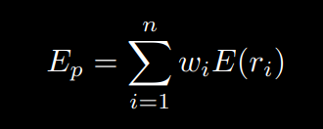
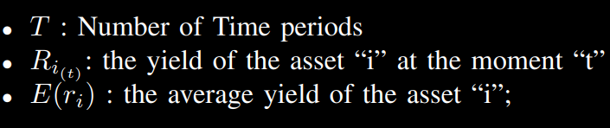
2B: Variables
Expected Return for Portfolio

Slide 8
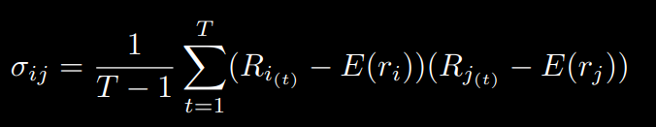
2B: Variables
2. Co Variance

Slide 9
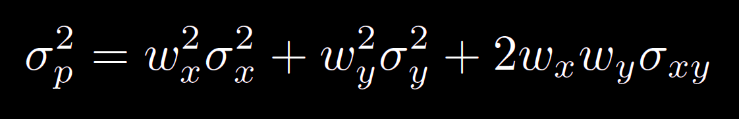

2B: Variables
Portfolio Variance of two assets ( x and y )

Slide 10
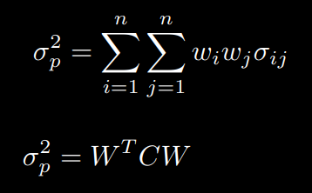
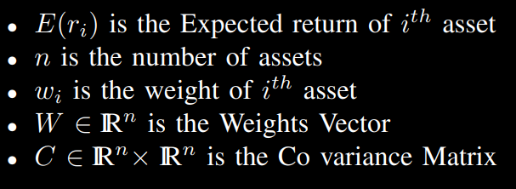
2B: Variables
4. Portfolio Variance of n assets

Slide 11

2B: Variables
5. Risk
In Markowitz Model, σ_{p} is considered to be the Portfolio Risk is influenced by:
The Individual risks of each asset included in the portfolio σ_{i}
The weight of each asset in the portfolio structure w_{i}
The covariance between the assets yields, considered two by two σ_{ij}

Slide 12
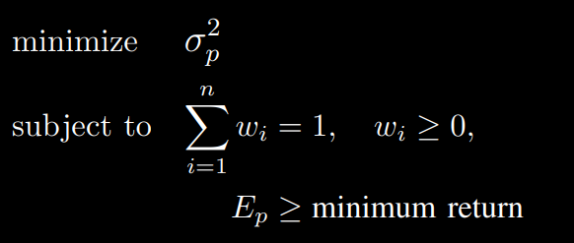
2C: Problem Formulation
Calculating Minimum Risk given Minimum Return:

Slide 13
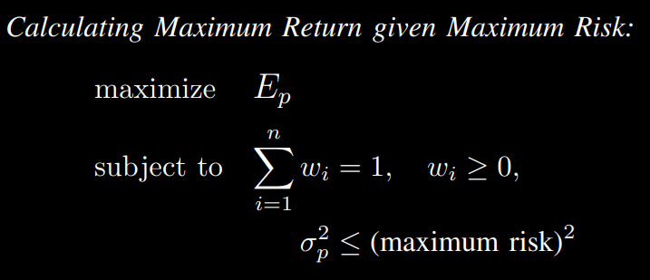
2C: Problem Formulation
2.

Slide 14
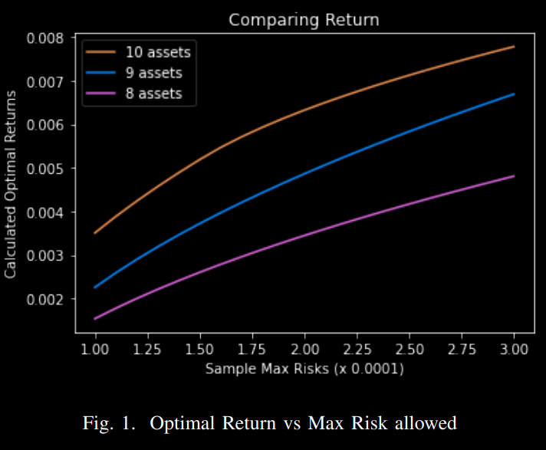
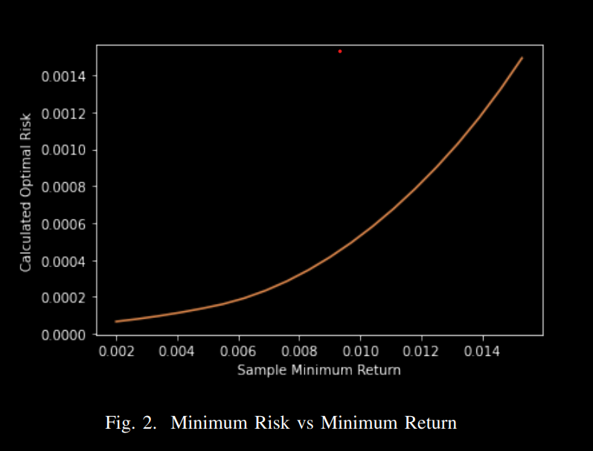
Comparing returns

Slide 15
3. The analysis of the return and risk
Comparing Maximum Return given Maximum allowed risk
We can clearly see that for the same amount of risk, investing a higher number of assets gives us better returns
We can infer that risk increases with return

Slide 16
4. Analysis
From the graph, we can infer that for a given risk, optimal return increases with diversification Therefore to invest in a portfolio, it is better to invest in more number of assets, i.e., diversifying the portfolio.

Slide 17
VaR and CVaR
Value at Risk(VaR)
Conditional Value at Risk(CVaR)
It is a statistical measure of the riskiness of financial entities or portfolios of assets. It is defined as the maximum dollar amount expected to be lost over a given time horizon, at a pre-defined confidence level.
Not sub-additive
Not convex
It is a risk assessment measure that quantifies the amount of tail risk an investment portfolio has.
CVaR is derived by taking a weighted average of the “extreme” losses in the tail of the distribution of possible returns, beyond the value at risk (VaR) cutoff point.

Slide 18
Methods to calculate VaR and CVaR
Historical method
Variance-Covariance method
Monte Carlo simulation.

Slide 19

Mathematical Formulation
x ∈ R^{n} is the decision vector where n in the number of assets chosen from a certain subset X of R^{n} S ∈ R^{q} is a vector of random variables denoting uncertainties (like Market Variables) that can affect the loss.
S is assumed to have probability density of p(S) for convenience, f(x, S) is the loss associated with the portfolio. The distribution of f is induced by S. The probability of the loss not exceeding a threshold αlpha is given by the cumulative distribution function, (αlpha is the maximum risk allowed)

Slide 20



Cont.
Let’s say β is the confidence level. VaR is the minimum value of α such that Ψ(x, α) ≥ β VaR associated with a portfolio x, for a specified confidence level β and time horizon t, is given by
Let’s assume Ψ(x, α) is smooth, CVaR is the conditional expectation of all the loss exceeding α_{β}(x) is
In can be expressed as

Slide 21
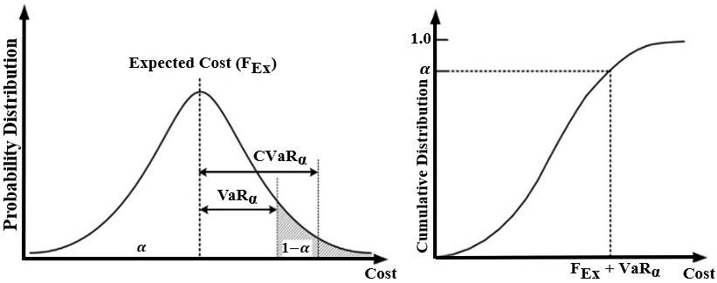
Cont.
Alpha in graph represents confidence (in previous slides we took confidence as beta)

Slide 22
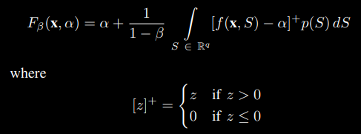

Cont.
Rockafellar and Uryasev proposed an augmented function to characterize both ϕβ(x) and αβ(x) as follow
The above integral in equation can be numerically approximated by Monte Carlo Approximation

Slide 23
MONTE CARLO Simulations
Monte Carlo simulations are used to model the probability of different outcomes in a process that cannot easily be predicted due to the intervention of random variables. It is a technique used to understand the impact of risk and uncertainty in prediction and forecasting models.
It is also referred to as a multiple probability simulation.

Slide 24
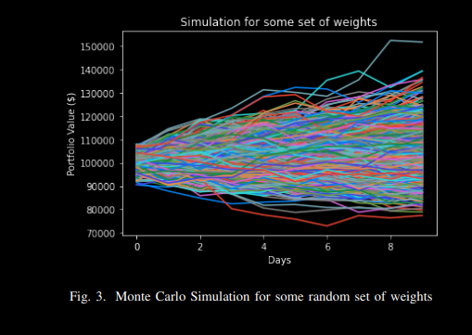
Monte Carlo Simulation Method
A Monte Carlo simulation takes the variable that has uncertainty and assigns it a random value. The model is then run and a result is provided. This process is repeated again and again while assigning the variable in question with many different values. Once the simulation is complete, the results are averaged together to provide an estimate.
Here, we apply Monte Carlo Simulations on k random weights and find CVaR and VaR for each of them using 1000 simulations of their returns for next 10 days.

Slide 25
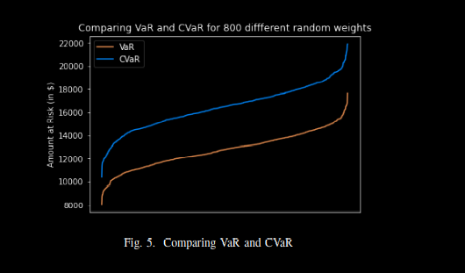
Comparing VaR and CVaR
From the figure we can see that CVaR is always greater than VaR. So, for a risk averse investor it always better to optimize CVaR instead of VaR.

Slide 26
Conclusions
From the figure we can see that CVaR is always greater than VaR. So, for a risk-averse investor, it is always better to optimize CVaR instead of VaR.
From the Mathematical Formulation, it can be observed that CVaR is a Convex Function and hence can be solved using the Convex Optimization techniques. Also, CVaR is sub-additive while VaR is not.
We thus conclude by stating that CVaR is a better form of risk measure than VaR.

Slide 27
References
Johnny Chow “Robustness of data-driven CVaR optimization using smoothing technique” Waterloo, Ontario, Canada - 2014, pp. 2–6
K.Nagarajan, J. Prabhakaran, Prediction of Stock Price Movements using Monte Carlo Simulation, in International Journal of Innovative Technology and Exploring Engineering (IJITEE) ISSN: 2278-3075, Volume-8 Issue-12, October 2019
Gabriela Victoria ANGHELACHE and Constantin ANGHELACHE, Diversifying the risk through portfolio investment in Theoretical and Applied Economics, Volume XXI (2014), No. 9(598), pp. 7-22

